Slide 1



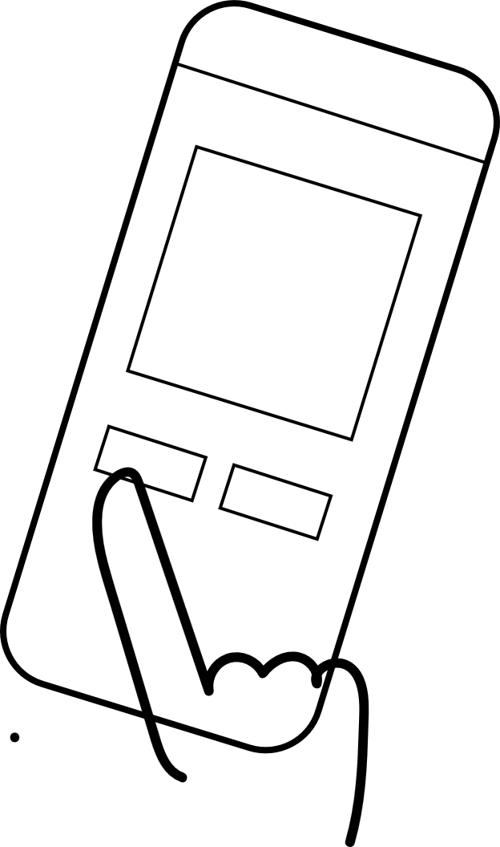


UX Design Storyboard
Scenario: Use Marigold Mold which is an accessible and easy to use app and enables users to choose and order their favorite flower or plant with necessary information about their maintanance.
Mary found it difficult to use complicated app
She downloads Marigold Mold app
Mary is happy because app offers information about the maintenance for plants
Once her plants withered due to lack of information
She chooses to order training video for her plants maintaining
Mary is happy with her healthy plants

